Slide 1
Used Car price prediction
Hetansh Patel

Slide 2
ABOUT Data
The dataset contains 3,000,040 rows.
Target field: Price
Number of attributes: 66 - These are the demographics and other features to describe a car
We can explore the possibility in predicting price based on the individual car information.

Slide 3
Data collection
Data Website: https://www.kaggle.com/datasets/ananaymital/us-used-cars-dataset

Slide 4
Problem Statement

Slide 5
Problem Statement
The find the perfect model for the customer so that they can predict there car sale price accurately with minimal information required.

Slide 6
Pre-Processing

Slide 7
Handling NA values
There were NA values in columns
Most of them are Character type. So we can’t just apply random values inside them. Its better to delete the entire rows rather than giving misleading information.

Slide 8
Dropping columns for analysis
Dropped columns which showed similar properties of a car or has no effect on price just by looking at them.

Slide 9
Data Exploration

Slide 10
Reviewing each feature
Body_type (object)
city_fuel_economy (float)
Engine_displacement (float)
Engine_type (object)
fleet (object)
Frame_damaged (object)
Franchise_dealer (bool)
Fuel_tank_volume(object)
Fuel_type (object)
Has_accidents (object)
Highway_fuel_economy (float)
Horsepower (float)
isCab (object)
Listing_color (object)
Make_name (object)
Maximum_seating (object)
mileage (float)
Owner_count (float)
torque (object)
Transmission_display (object)
Wheel_system (object)
year (int)
price (Target Variable) (float)

Slide 11
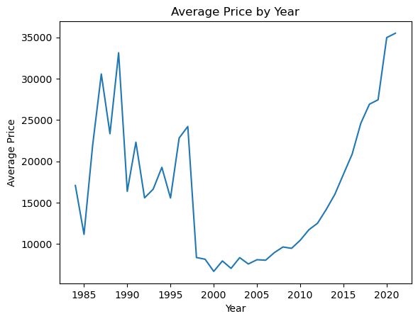
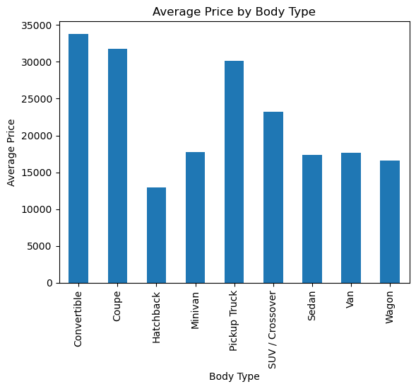
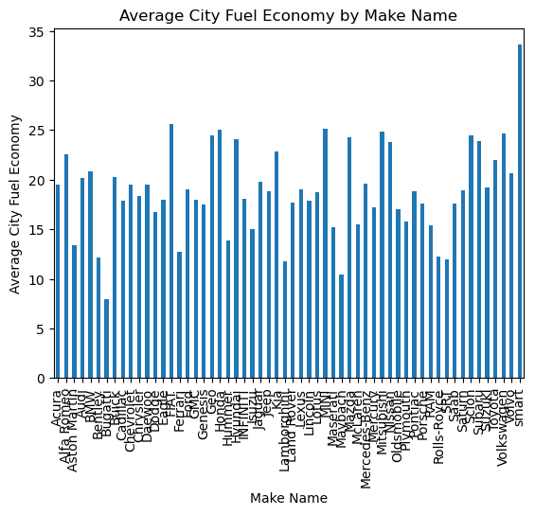
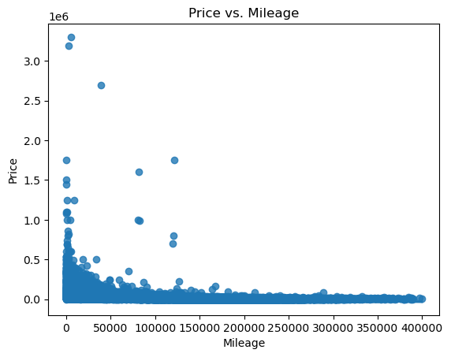
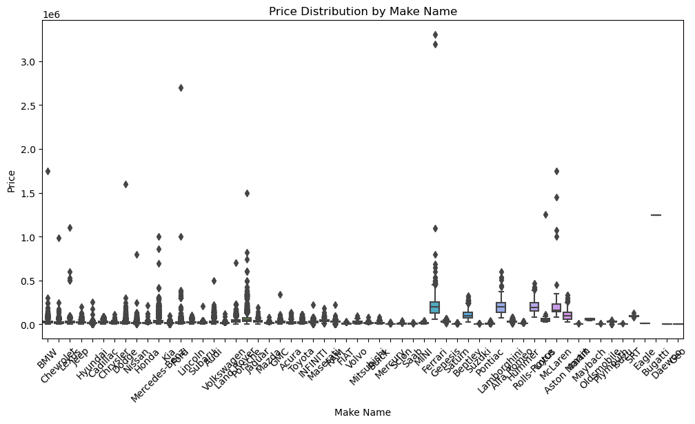
Overview of data

Slide 12
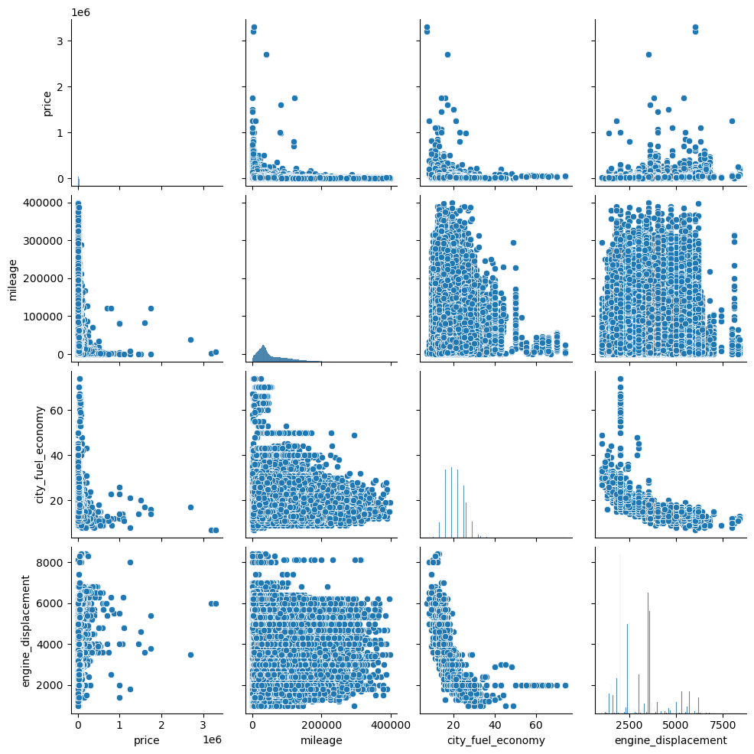
Overview of data

Slide 13
Data Transformation

Slide 14
Giving categories
There were some features that had character type but had numerical information. There were outliers with extreme values, it was very necessary to remove them because they were diverting data to upper side.

Slide 15
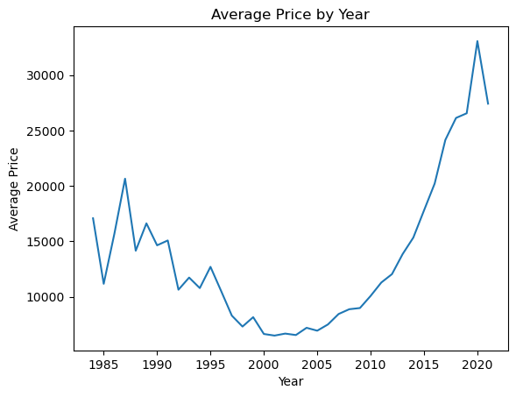
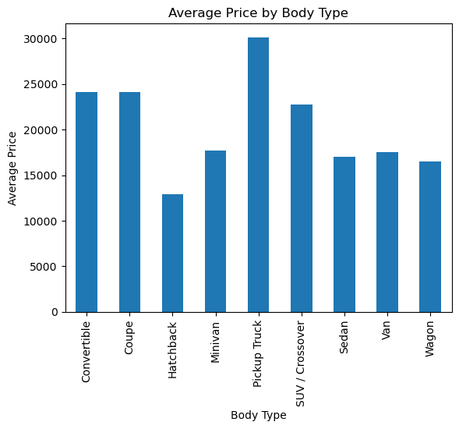
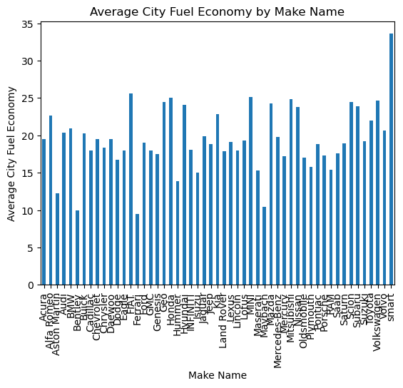
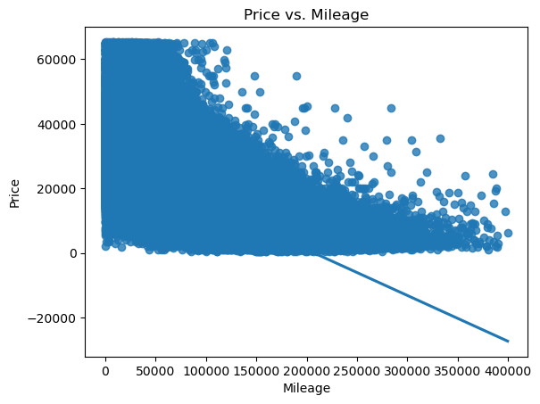
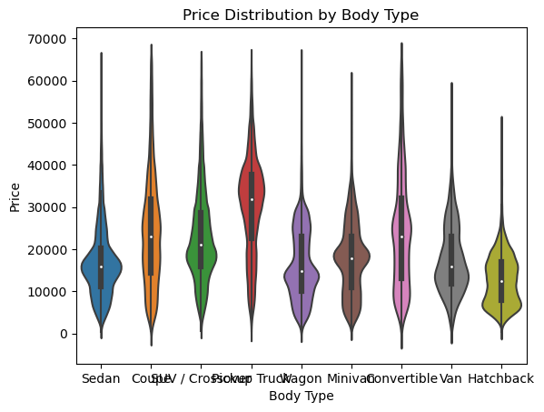
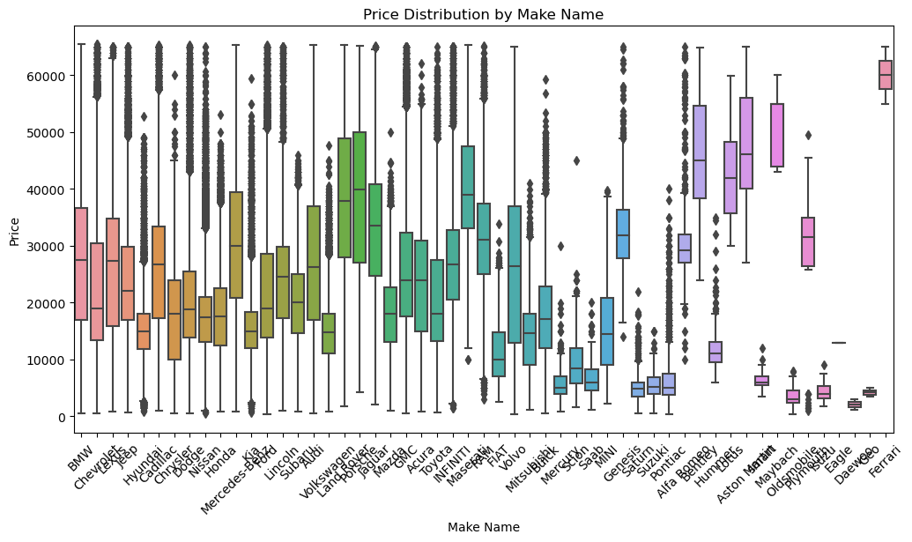
Overview of data

Slide 16
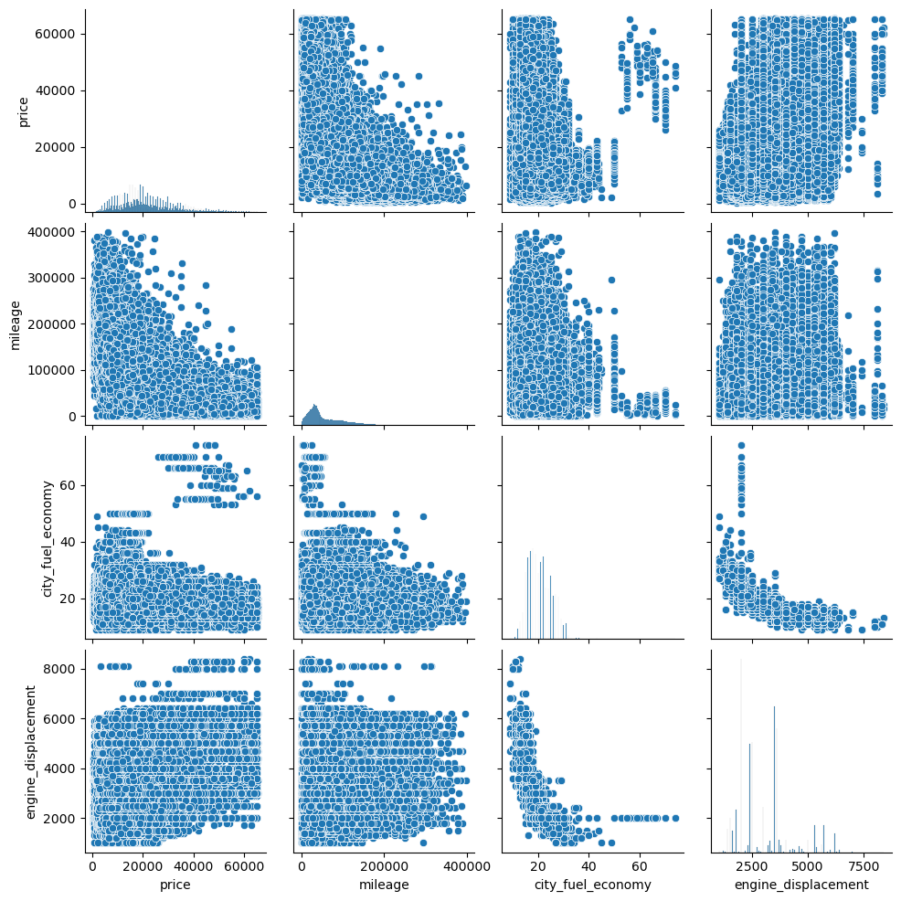

Slide 17
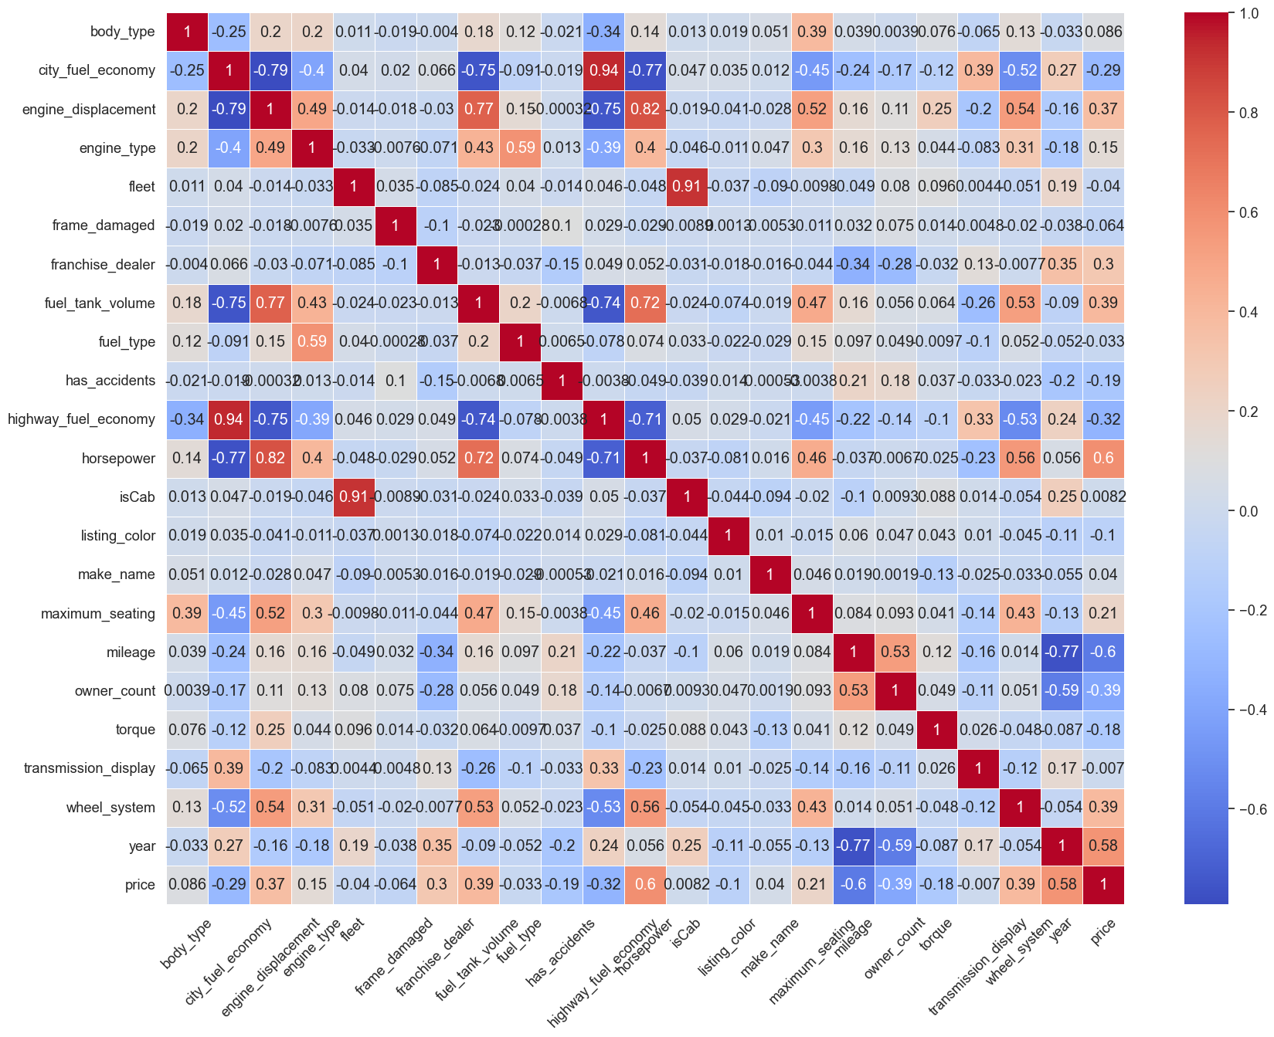
Correlating data
Objective of this was to discern which features within the dataset held the most relevance and which ones were less informative. This process allows us to gain insights into the interrelationships between different variables. It is important to eliminate less influential features to reduce dimensionality and enhancing the efficiency of our analysis. This approach to data reduction ensures to focus more on critical aspects of data.

Slide 18
Methodology

Slide 19
Algorithms
Decision Trees
Random Forest
Support Vector Machines
Naïve Bayes
Logistics Regression
XGB Tree
KNN

Slide 20
Results

Slide 21
Random Forest
With 22 features
With 4 features
Metric | Value
R Squared | 0.9294
MSE | 0.3350
Metric | Value
R Squared | 0.8688
MSE | 0.6225

Slide 22
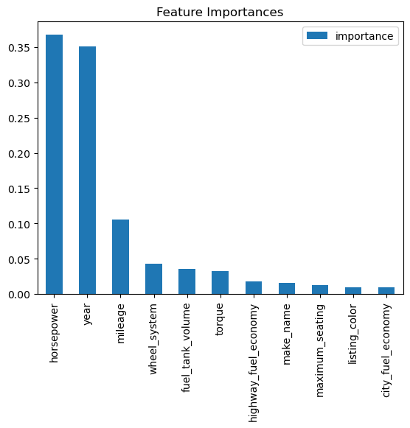
Importance of features

Slide 23
Use Cases
Credit scoring
Financial institutions can use the analysis to assess an individual's creditworthiness. By considering income, employment, and other factors, they can make informed decisions on lending and setting interest rates.
Marketing
Companies can target their marketing efforts more effectively by understanding the income and demographic profiles of their customers. This can lead to personalized advertising and product recommendations.
Government policy
Governments and policymakers can use the analysis to design and evaluate social programs, tax policies, and measures aimed at reducing income inequality or improving economic conditions for specific demographic groups.
Education planning
Educational institutions can use the information to create targeted scholarship programs, improve educational outcomes, and provide resources to students from underprivileged backgrounds.

Slide 24
THANK YOU
Any Questions?

